Slide 1


Bridging Silence with AI: A Sign Language Detection Model
Team: GestureGenius
Team Members:
Antra Bali - 2022A6R010
Sukriti Chadha - 2022A6R048
Palak - 2022A6R031

Slide 2
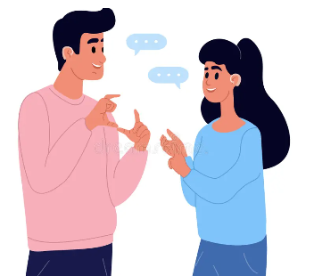
Introduction
"According to WHO, over 430 million people worldwide have disabling hearing loss."
Communication barriers still isolate the speech and hearing impaired.
Sign language is powerful but often misunderstood or ignored.
We aim to bridge this silence with an innovative AI-based approach that enables real-time understanding of sign language.

Slide 3
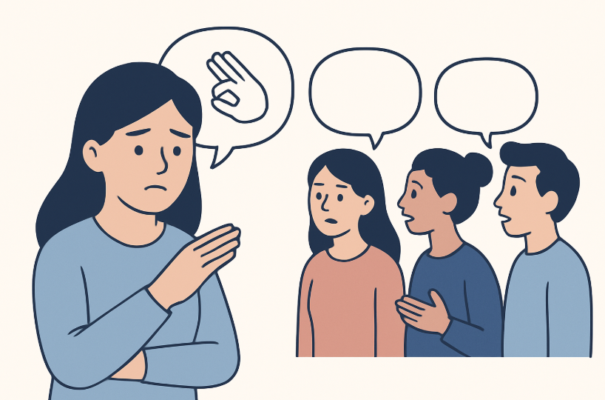

Problem Statement
The Communication Gap
Speech and hearing-impaired individuals face daily barriers in expressing themselves.
Lack of interpreters leads to misunderstanding, isolation, and reduced opportunities.
Existing systems don’t offer real-time, scalable, or accessible solutions.
80% of deaf people live in low- or middle-income countries with limited access to interpreters. (World Federation of the Deaf)

Slide 4
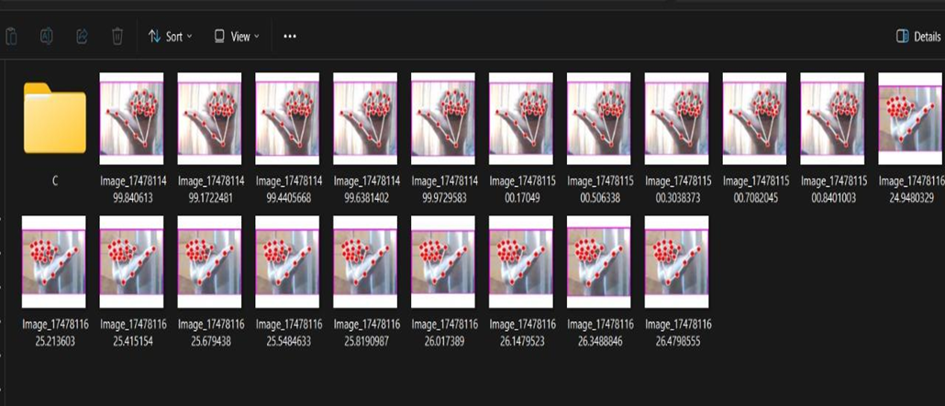
Solution Offered
We built a CNN-based image classifier to detect sign gestures.
High accuracy with augmentation
Saved model for deployment
Performance metrics included
Custom Training the Dataset

Slide 5
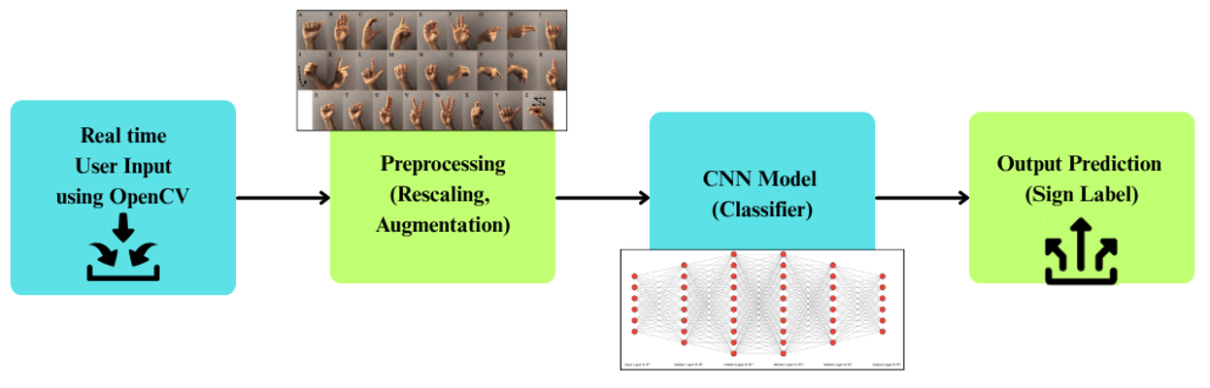
DFD (Data Flow Diagram)
This is our Level 1 Data Flow Diagram representing the core pipeline — starting from image input, preprocessing for model readiness, classification using our CNN, and finally the predicted sign label as output.

Slide 6
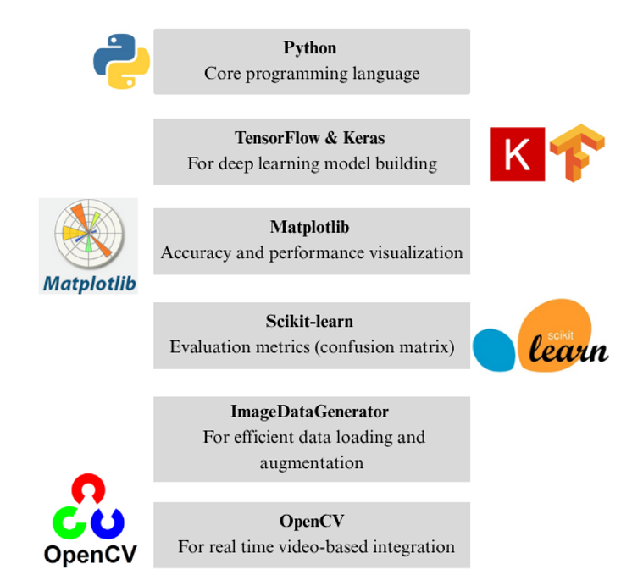
Tech Stack

Slide 7
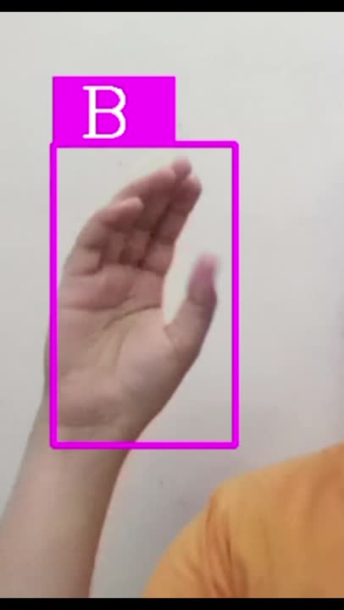
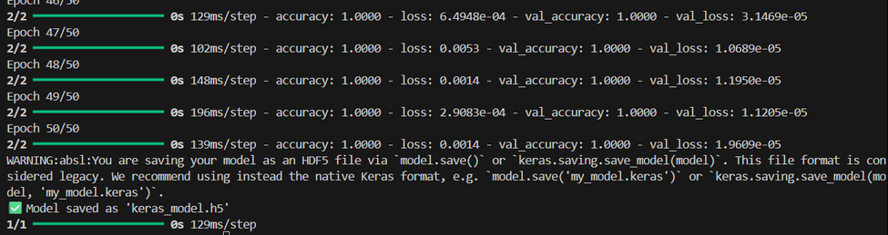
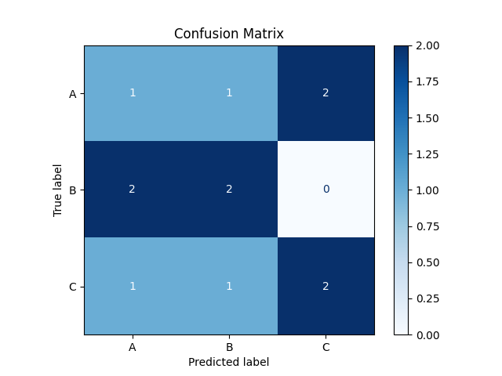
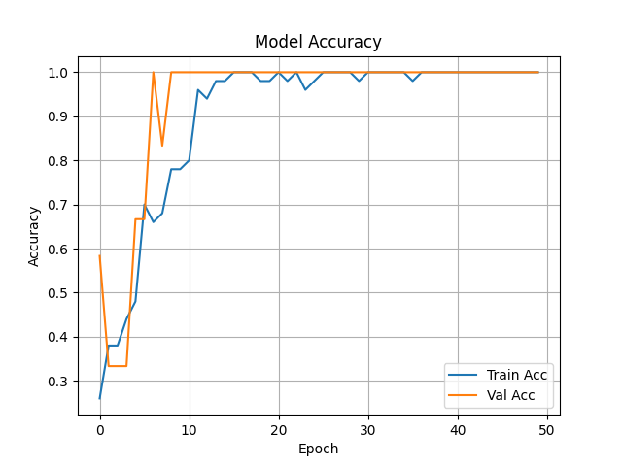
Output

Slide 8
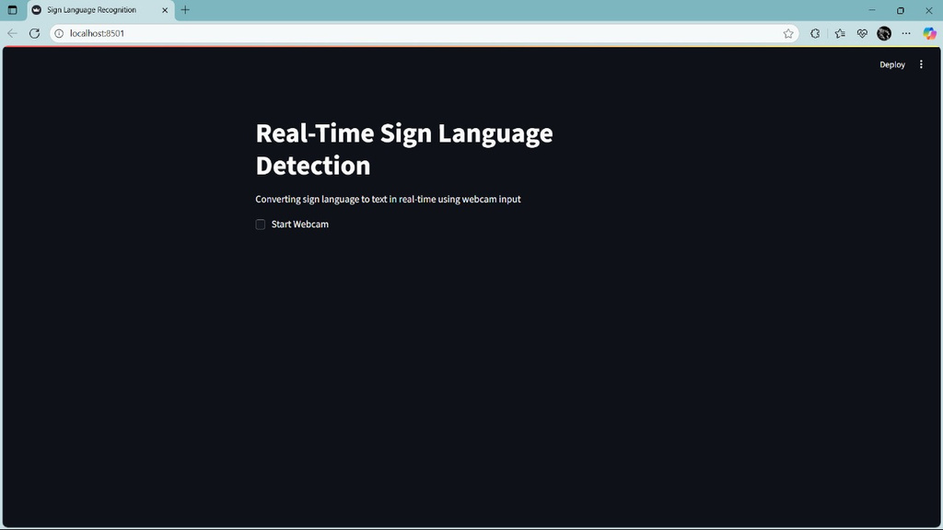
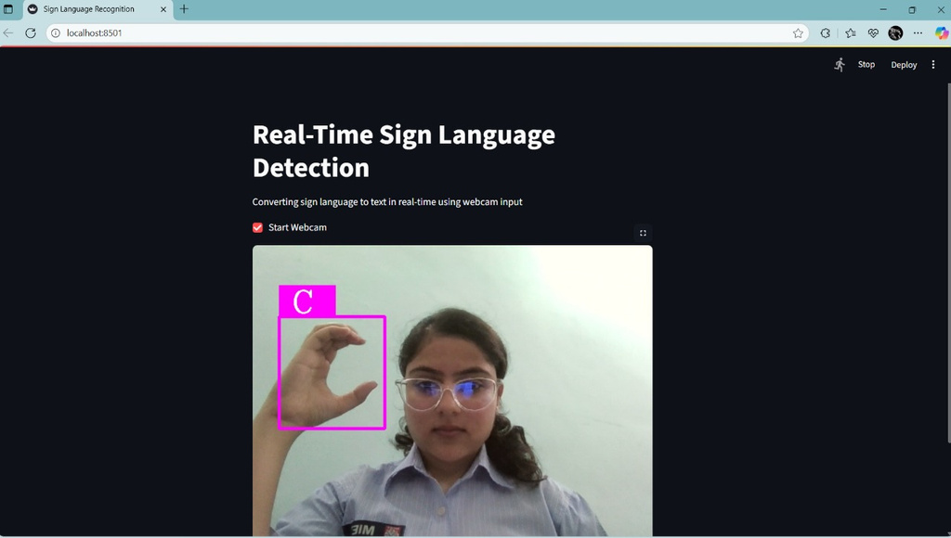
Streamlit Application

Slide 9

Future Enhancements
Integrate real-time video input
Expand gesture dataset
Deploy as mobile/web app
Add voice synthesis of predicted signs
Git Hub Link

Slide 10

We welcome your questions

Slide 11


